Slide 1
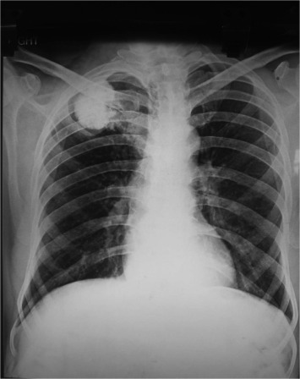
SAT 4650 ( FINAL PROJECT ) Manual Tumor detection from x-ray along with the tumor description using a python program. (Presented BY: SIFAT NASEEM)

Slide 2
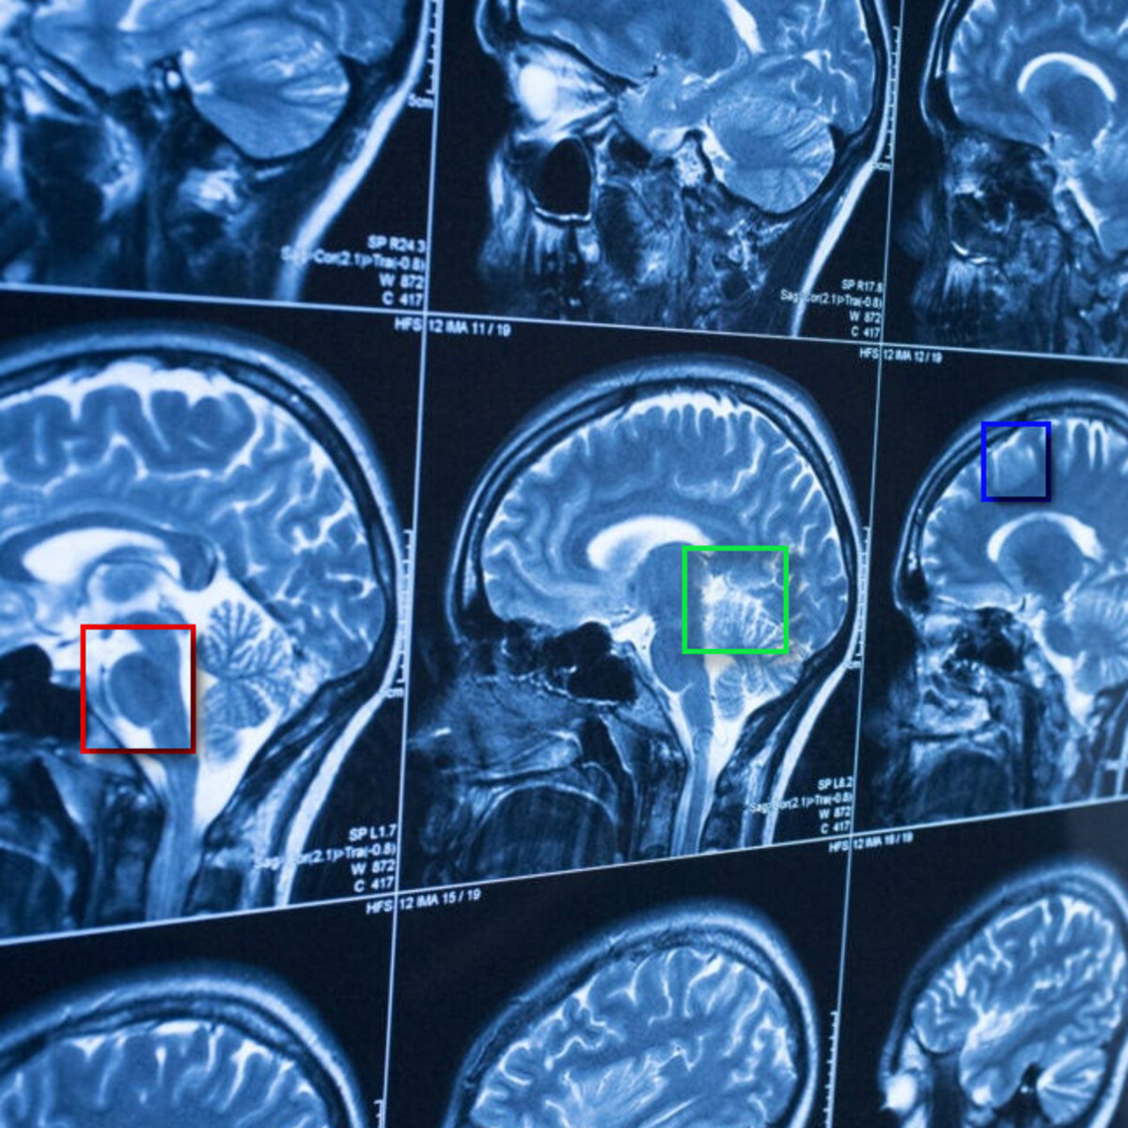
Contents:
AIM
DEMO
APPLICATION
REFERENCE

Slide 3

AIM:
The basic aim of the project is to:
1
Help the user manually annotate X-ray images for tumor detection.
2
Add a description of the tumor for future reference
3
save the annotated image as a png.
Save the description of tumor as text file and save the location of tumor.
4

Slide 4

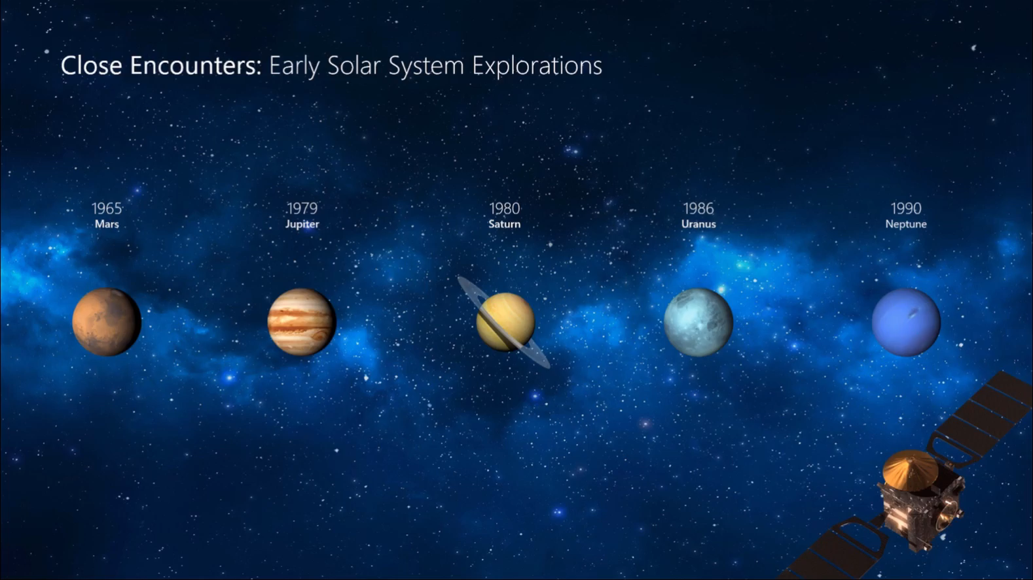
DEMO OF PROGRAM
MODULES USED:
Tkinter
pillow

Slide 5
Application:
This will allow the user to keep a record or track of the disease.
It will ultimately save the user’s time.
Help them to make better-informed decisions.
Improve patient outcomes.
Improve interoperability

Slide 6
Reference
1
Course Module
2
https://www.google.com/search?q=chondrosarcoma+of+rib&rlz=1C1CHBF_enIN965IN965&source=lnms&tbm=isch&sa=X&ved=2ahUKEwiAiL6ew-v7AhXtl4kEHQ_rA2oQ_AUoAXoECAIQAw&biw=1366&bih=649#imgrc=eQ0UZt3B9l9H9M
THANK YOU

